Slide 1



Design and Development of IoT-Based Smart Maldive Fish Processing System
RP-26-IT-028

Slide 2

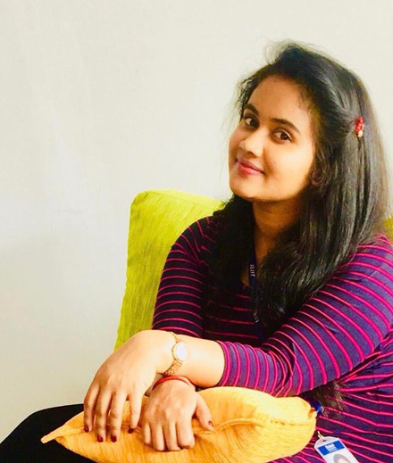



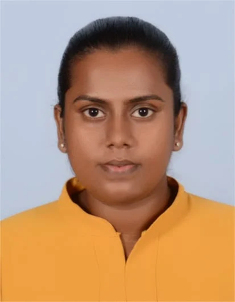
OUR TEAM MEMBERS
Mr. Supunya Swarnakantha
Ms. Dulani Jayasinghe
Supervisor
Co - Supervisor
RP- 26-IT-028

Slide 3
Design and Development of IoT-Based Smart Maldive Fish Processing System
Comments | How we addressed it
Comment 1: Data sources were not clear | Raw fish image data will be used for AI-based raw fish quality grading. Dried fish image data will be used for final dried fish quality evaluation. IoT sensor data will be collected from the processing and drying environment. Sensor data includes VOC, moisture, temperature, humidity,, salinity, and water-level readings.
Comment 2: Features/factors were not clearly explained | Raw fish quality checking using computer vision. Processing optimization using IoT sensors and images. Drying environment monitoring using temperature, humidity, and airflow sensors. Final dried fish grading using image data and VOC sensor data. Dashboard will show real-time monitoring, alerts, quality reports, and system status.
Comment 3: Integration between components was unclear | Each component collects its own data and sends results to the central dashboard. AI and IoT outputs are combined to support better decision-making. The system connects raw fish inspection, processing optimization, environmental monitoring, and final quality evaluation.
Comment 4: Scope was too broad | Reduced the scope into four clear and manageable components. Each member focuses on one specific part of the system. The system now focuses only on Maldive fish processing quality improvement. PP1 focuses on training model, prototype development, front-end, main functionalities, and integration.
RP-26-IT-028

Slide 4
Design and Development of IoT-Based Smart Maldive Fish Processing System
Main Problem
Maldive fish processing still depends heavily on manual inspection.
Manual checking can cause inconsistent quality decisions.
Spoiled or low-quality fish may enter the processing line.
Traditional drying and processing conditions are difficult to control.
Environmental issues such as humidity, dust, odor, and poor airflow affect fish quality.
Impact
Inconsistent fish quality in the market.
Increased labor cost. Slow processing and inspection.
Reduced hygiene and food safety.
Risk of poor-quality products reaching customers.
Reduced export standard and market trust.
RP-26-IT-028

Slide 5
Design and Development of IoT-Based Smart Maldive Fish Processing System
Main Users
Fish processing operators.
Seafood exporters.
Distributors.
Consumers indirectly benefit from safer and better-quality products.
Key Features
AI-based raw fish quality assessment.
Smart optimization of mechanical efficiency and salt distribution.
IoT-based environmental monitoring for drying areas.
Multi-sensor quality evaluation for dried Maldive fish.
Benefits
Reduces manual inspection errors.
Improves fish quality consistency.
Supports faster quality decisions.
Improves processing efficiency
RP-26-IT-028

Slide 6
AI-Driven Raw Fish Quality Assessment & Standardization
IT22300096 | Madurawala M. D. S. S.| RP-26-IT-028

Slide 7
AI-Driven Raw Fish Quality Assessment & Standardization
Problem
Raw fish quality is currently checked manually.
Manual grading causes human errors.
Inspection process is slow.
Substandard fish may enter production.
Manual grading increases labor dependency
Solution
Develop an AI-based computer vision system.
Capture raw fish images using a camera.
Detect defects and classify fish quality.
Classify fish into Grade A, Grade B, or Reject.
Send results to the dashboard for monitoring.
User Requirements Addressed
User needs faster raw fish quality checking.
User needs accurate and consistent grading.
User needs reduced manual inspection.
User needs automatic sorting support.
User needs quality reports for decision-making.
IT22300096 | Madurawala M. D. S. S.| RP-26-IT-028

Slide 8
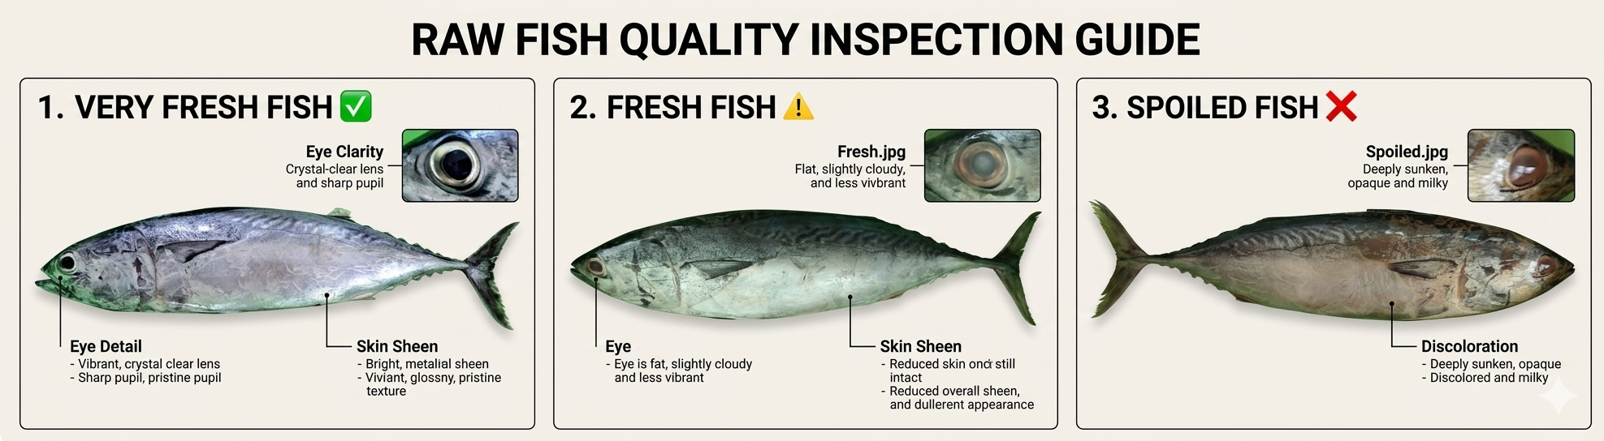
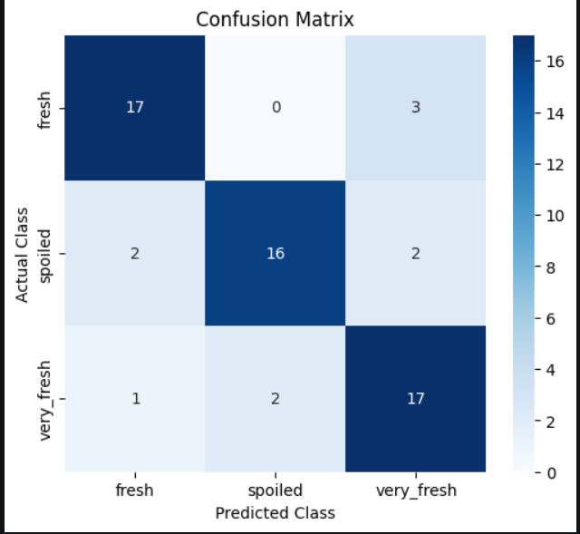
AI-Driven Raw Fish Quality Assessment & Standardization
Design Excellence / Contribution
Uses AI and computer vision for raw fish inspection.
Uses YOLO-based detection for real-time defect detection.
Supports automated grading before fish enters the processing line.
Reduces dependency on manual judgment.
Improves standardization of raw fish quality
Technologies
Python.
YOLO11s
Google Colab.
Camera module.
Evaluation matrix
Accuracy – 83%
Precision – 84%
Recall – 83%
F1-score – 83%
IT22300096 | Madurawala M. D. S. S.| RP-26-IT-028

Slide 9
Smart Optimization of Mechanical Efficiency and Salt Distribution using IOT AI
IT22341686| Ramesh J N G A | R26-IT-028
ITXXXXXXXX | <<Student Name>> | <<Project ID>>

Slide 10
Smart Optimization of Mechanical Efficiency and Salt Distribution in Maldive Fish Processing
Problem
Traditional boiling and salting methods are manually controlled.
Incorrect salt levels affect product quality.
Poor water-level control affects processing consistency.
Mechanical inefficiency increases energy usage and processing time.
Manual control can lead to waste and uneven quality.
Solution
Use IoT sensors to monitor processing conditions.
Monitor RPM, torque, water level, salinity, temperature, and humidity.
Use AI/ML to support process optimization.
Automatically suggest or trigger adjustments.
Send processing data to the dashboard.
User Requirements Addressed
User needs stable salt distribution.
User needs better water-level monitoring.
User needs efficient machine operation.
User needs reduced processing waste.
User needs real-time processing condition updates.
IT22341686| Ramesh J N G A | R26-IT-028

Slide 11
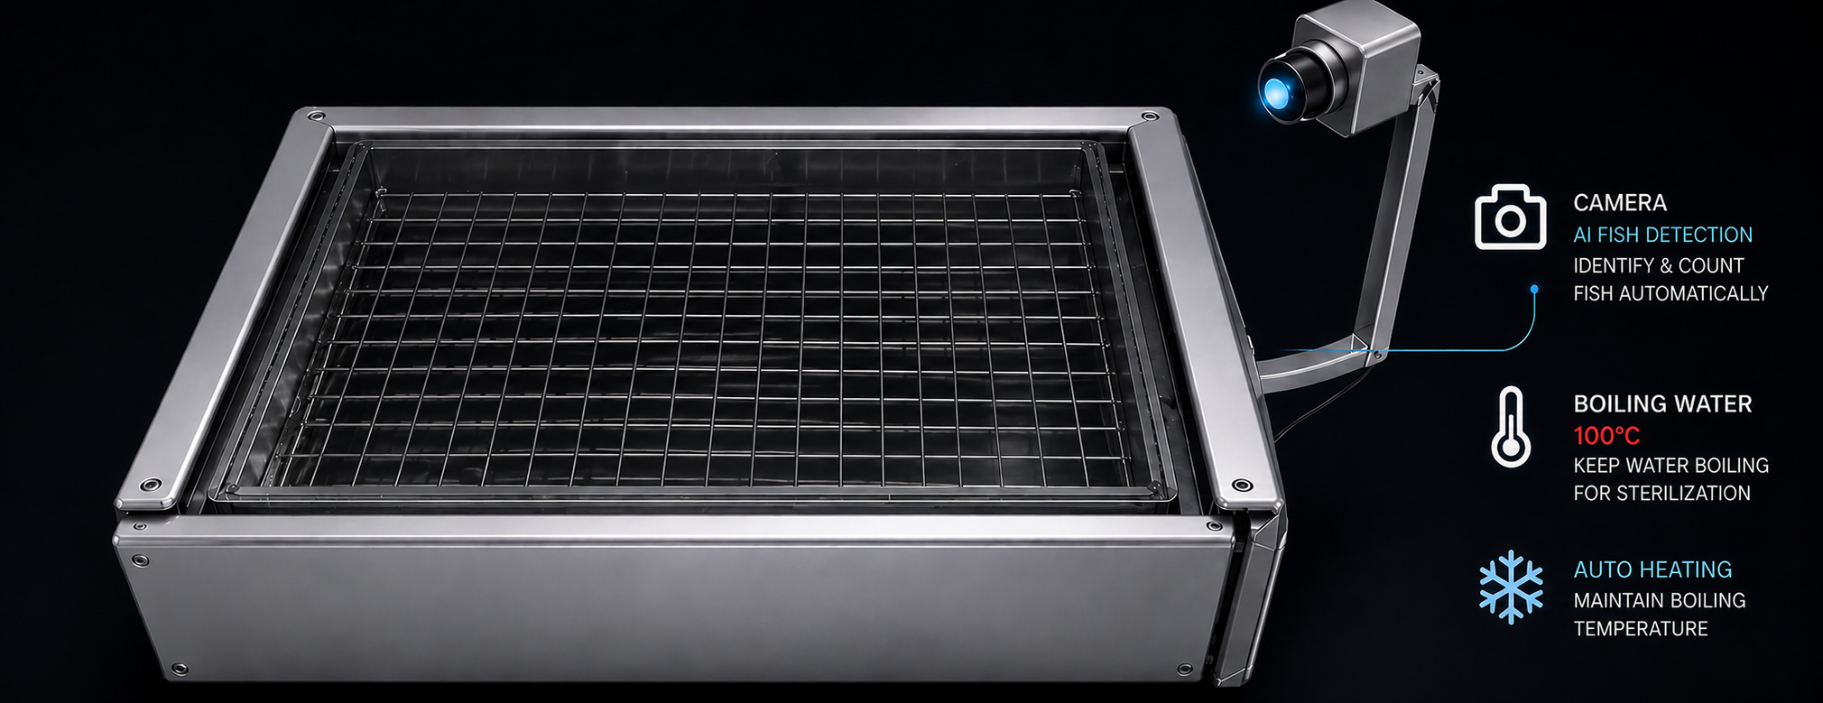
Smart Optimization of Mechanical Efficiency and Salt Distribution in Maldive Fish Processing
Design Excellence / Contribution
Combines IoT sensor monitoring with AI-based optimization.
Supports real-time control of mechanical and processing parameters.
Improves consistency of Maldive fish processing.
Helps reduce energy waste and post-processing losses.
Adds smart decision-making to traditional processing methods.
Technologies
IoT sensors.
RPM sensor.
Torque sensor.
Water-level sensor.
Salinity sensor.
Temperature and humidity sensors.
Raspberry Pi / ESP32.
AI/ML models.
Evaluation
Salt uniformity.
Water-level stability.
Mechanical efficiency.
Energy usage.
Processing time.
IT22341686| Ramesh J N G A | R26-IT-028

Slide 12
Intelligent IoT-Based Multi-Parameter Environmental Monitoring for Fish Processing Optimization
IT22340214 | Bandara CS | R26-IT-028

Slide 13
Intelligent IoT-Based Multi-Parameter Environmental Monitoring for Fish Processing Optimization
Problem
Fish drying is highly affected by weather conditions.
Rainy or cloudy days slow down drying.
Rust, dust, and animal waste can contaminate fish.
Poor airflow affects drying efficiency.
Spoilage may occur if environmental conditions are not monitored.
Solution
Develop an IoT-based environmental monitoring system.
Monitor temperature, humidity, ammonia gas, and airflow.
Detect unsafe environmental conditions.
Send real-time data to a cloud dashboard.
Generate alerts when values exceed safe limits.
User Requirements Addressed
User needs real-time drying environment monitoring.
User needs early warning for spoilage.
User needs alerts for unsafe conditions.
User needs better control of drying quality.
User needs historical environmental data for analysis
IT22340214 | Bandara CS | R26-IT-028

Slide 14
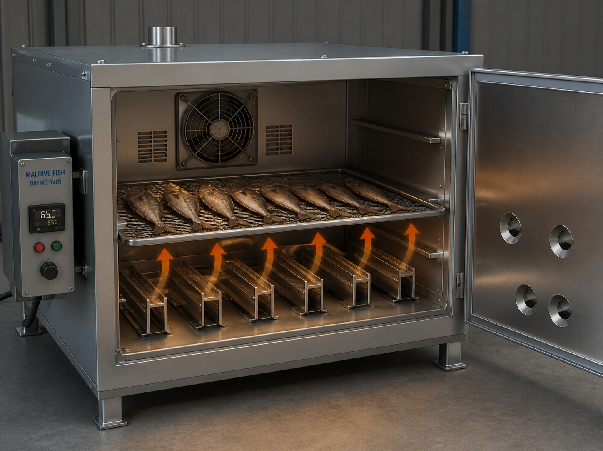
Intelligent IoT-Based Multi-Parameter Environmental Monitoring for Fish Processing Optimization
Design Excellence / Contribution
Uses multiple environmental sensors in one system.
Ammonia detection helps identify early spoilage signs.
Airflow monitoring supports better drying efficiency.
Threshold-based alerts help operators take quick action.
Technologies
ESP32
Temperature sensor
Humidity sensor
Ammonia gas sensor
Airflow sensor
Evaluation
Sensor accuracy.
Response time.
Data transmission reliability.
Alert generation accuracy.
Comparison with standard measuring devices.
System performance during drying process.
IT22340214 | Bandara CS | R26-IT-028

Slide 15
AI-Based Multi-Sensor Quality Evaluation System for Dried Maldive Fish
IT22224934 | SANCHALA W K S | R26-IT-028

Slide 16
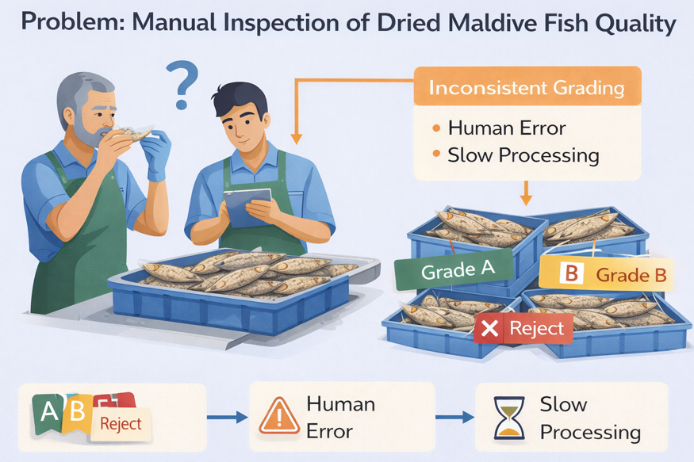
AI-Based Multi-Sensor Quality Evaluation System for Dried Maldive Fish
Problem
Manual inspection for dried fish quality is slow, inconsistent, and prone to human error.
Odor-based spoilage (related to VOCs) cannot be detected visually.
No system exists for predicting expiry date using VOC levels in dried fish.
Solution
VOC sensor used to detect spoilage and estimate expiry date of dried Maldive fish.
Use AI-based image processing for quality grading.
Real-time monitoring system that uses VOC sensor data to predict fish shelf life.
User Requirements Addressed
Users need to automatically predict the expiry date of dried fish.
Users need faster and more accurate quality inspection.
Users require real-time monitoring of fish quality and spoilage.User needs dashboard-based quality reports.
IT22224934 | SANCHALA W K S | R26-IT-028

Slide 17
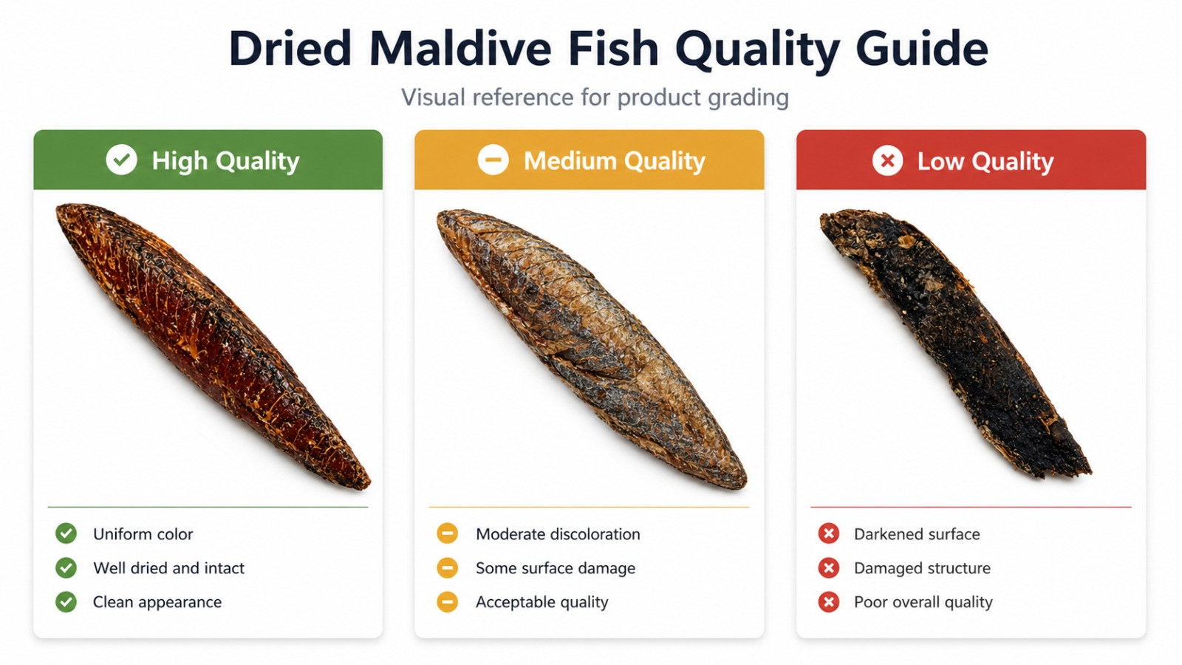
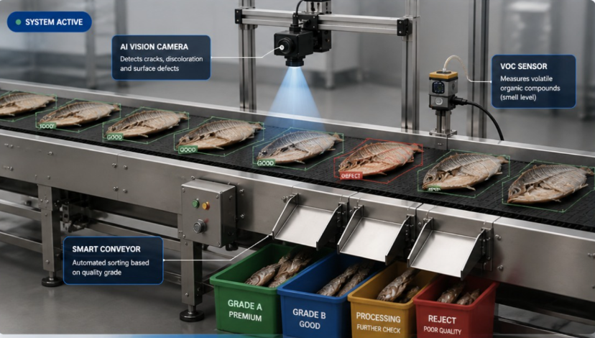
AI-Based Multi-Sensor Quality Evaluation System for Dried Maldive Fish
Design Excellence / Contribution
VOC sensor detects spoilage-related gases and predicts the expiry date of dried fish.
AI-based image processing handles visual defect detection and quality grading.
Real-time multi-sensor monitoring system for shelf life prediction.
Technologies
Python, PyTorch, ResNet-18 (for image classification)
VOC sensor / MQ-135 (for spoilage detection)
Raspberry Pi / ESP32 (for IoT integration)
Dashboard system (for real-time monitoring)
Evaluation matrix
Accuracy – 78%
Precision – 77%
Recall – 78%
F1-score – 77%
IT22224934 | SANCHALA W K S | R26-IT-028

Slide 18
AI-Based Multi-Sensor Quality Evaluation System for Dried Maldive Fish
Commercialization and Sustainability
Commercialization
The system can be used in Maldive fish processing factories.
It can be sold as an automated fish quality monitoring solution.
It can support small and medium seafood processing businesses.
It can be used by seafood exporters to maintain quality standards.
Target Market
Maldive fish processing factories.
Seafood export companies.
Small and medium fish processing industries.
Fish quality inspection laboratories.
What Is Unique?
Combines AI, IoT sensors, computer vision, VOC detection, and dashboard monitoring.
Covers the full Maldive fish processing workflow.
Supports raw fish inspection, processing optimization, drying monitoring, and final dried fish grading.
Provides real-time alerts and quality reports.
IT22224934 | SANCHALA W K S | R26-IT-028

